Slide 1
Practical Issues
🎨🔬📝
Applied Machine Learning in R
Pittsburgh Summer Methodology Series
Lecture 4-B July 22, 2021

Slide 2




Lecture Topics
Planning Studies
Identifying interesting questions; sample size
Interpreting Results
Data quality; when to trust your model
Writing
What to include in Methods/Results; publication-ready figures
Reviewing
Takeaways, questions, future directions

Slide 3
Background

Slide 4
Major Depressive Disorder: Criteria
Criterion A: Five or more of the following symptoms are present during the same 2-week period
Depressed mood most of the day, nearly every day*
Significantly decreased interest or pleasure in previously enjoyed activities*
Significant weight loss or weight gain or increase in appetite or decrease in appetite
Insomnia or hypersomnia
Psychomotor agitation or retardation
Fatigue or loss of energy
Feelings of worthlessness or excessive or inappropriate guilt
Diminished ability to think or concentrate or indecisiveness
Recurrent thoughts of death or suicidal thinking without a suicide plan or a specific suicide plan or a suicide attempt
*must include at least one of these

Slide 5
Major Depressive Disorder: Criteria
Criterion B: The symptoms cause clinically significant distress or impairment.
Criterion C: Not attributable to physiological effects of a substance or another medical condition.
Criterion D: Not better explained by schizoaffective disorder, schizophrenia, schizophreniform disorder, delusional disorder, or other schizophrenia spectrum or psychotic disorders.
Criterion E: There has never been a manic or hypomanic episode.
NOTE: Bereavement criterion removed from DSM-IV → DSM-5.

Slide 6
Major Depressive Disorder: Prevalence & Development
Lifetime prevalence: approximately 20%.
Females have approximately 1.5 – 3-fold higher rates than males.
Average age-of-onset between 20 – 30 years old.
Common comorbidities:
Generalized anxiety disorder
Panic disorder
Post-traumatic stress disorder
Obsessive-compulsive disorder
Substance use disorders
Eating disorders (e.g., anorexia nervosa, bulimia nervosa, binge-eating disorder)
Personality disorders (e.g., borderline personality disorder, narcissistic personality disorder)
Treatments: cognitive-behavioral therapy, unified protocol, behavioral activation, antidepressants

Slide 7
Major Depressive Disorder: Critiques
Major depressive disorder is extremely heterogeneous.
Based on the diagnostic criteria, there are 10,377 unique ways* to meet DSM-5 diagnostic criteria.
A recent study found over 1,000 unique symptom profiles in 3,700 patients diagnosed with MDD¹.
The current diagnostic system treats all nine symptoms as equivalent, though they are clearly different in form (e.g., behavior vs. cognition vs. physical health) and severity (e.g., fatigue vs. suicide attempt).
There is no clear rationale for the five-symptom cut-off (“four was too few, six was too many”).
Treating MDD as a single, consistent syndrome is questionable and likely misses meaningful symptom-level variability that could provide important information about treatment.
*Depending on how compound criteria are split, there are between 227 – 16,400 unique MDD profiles.
¹ Fried & Nesse (2015); Journal of Affective Disorders

Slide 8
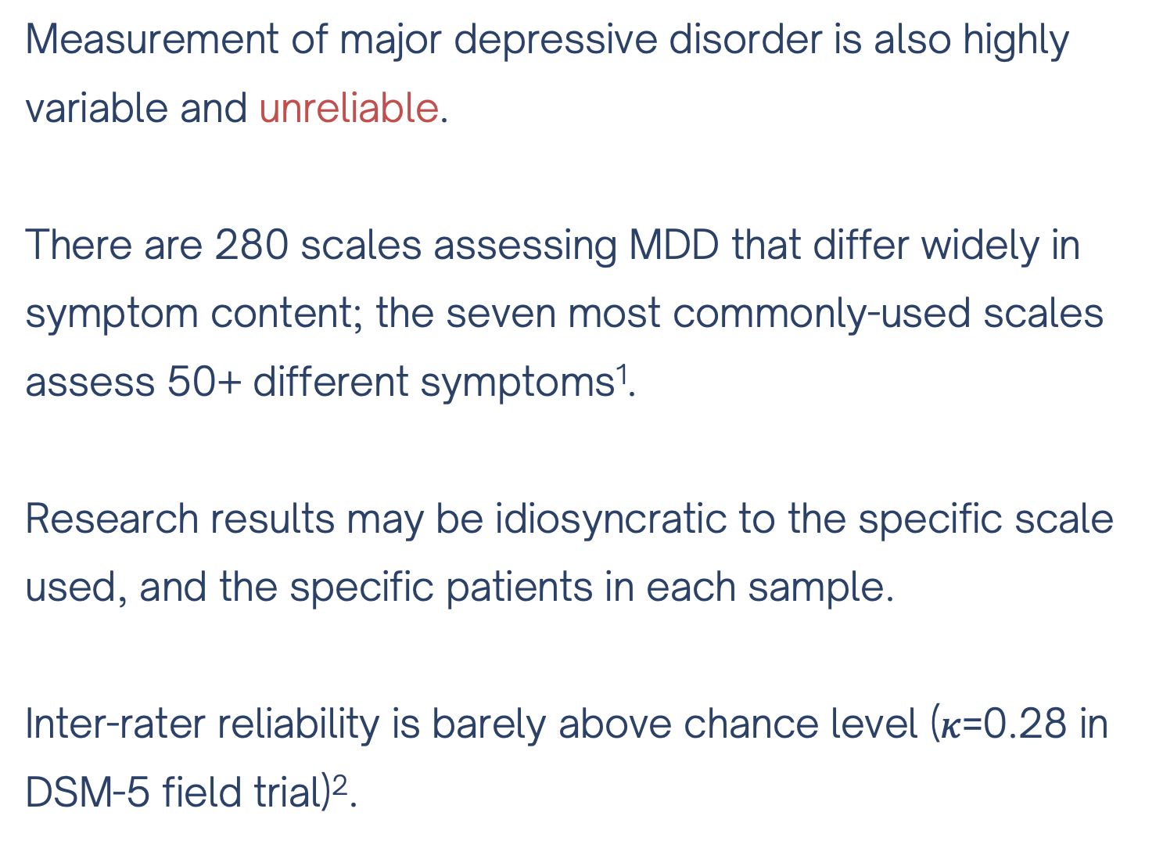
Major Depressive Disorder: Critiques
Measurement of major depressive disorder is also highly variable and unreliable.
There are 280 scales assessing MDD that differ widely in symptom content; the seven most commonly-used scales assess 50+ different symptoms¹.
Research results may be idiosyncratic to the specific scale used, and the specific patients in each sample.
Inter-rater reliability is barely above chance level ($κ$=0.28 in DSM-5 field trial)².
¹ Fried (2017); Journal of Affective Disorders, ² Regier et al (2013); American Journal of Psychiatry

Slide 9
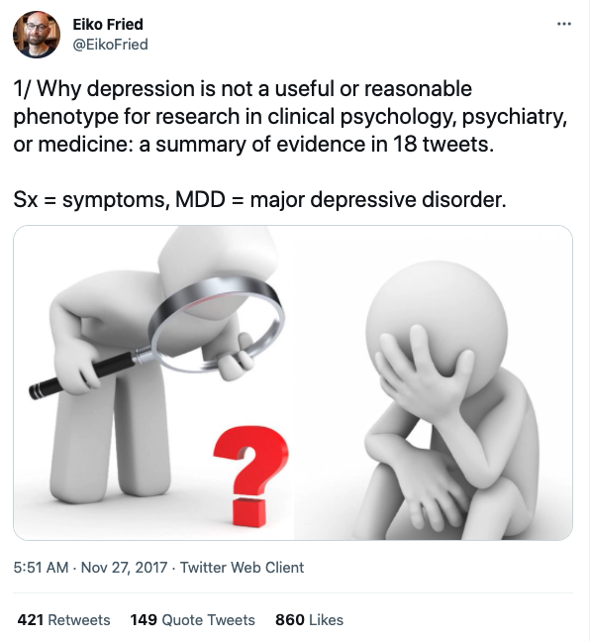
Major Depressive Disorder: Critiques
For more quick & easy-to-read info, I highly recommend this twitter thread by Eiko Fried:
https://twitter.com/EikoFried/status/935098850439847937

Slide 10
Current Study

Slide 11
Current Study
Pavlovian-instrumental transfer (PIT): the ability of passively-conditioned (Pavlovian) cues to automatically invigorate or suppress ongoing goal-directed instrumental behavior.
Arises from an interaction between two associative learning processes: Pavlovian and instrumental.
Demonstrated in both animal and human studies.
Could a disruption in the mechanisms that mediate PIT be driving depression symptoms?

Slide 12
Current Study
The authors argue that depression involves hyper-sensitive responses to negative stimuli, as well as hypo-sensitive responses to positive material.*
If behavior in depression is disproportionately guided by negative processing, we should see an enhancement of aversive PIT in people with depression compared to healthy controls.**
The rationale for the study was to investigate PIT in depression without the potentially confounding effects of current medication, which is known to alter serotonergic processing and could thus affect PIT.***
Hypothesis: unmedicated depressed patients would show excessive influence of aversive Pavlovian cues, and diminished influence of appetitive Pavlovian cues, compared to healthy controls.

Slide 13
Methods

Slide 14
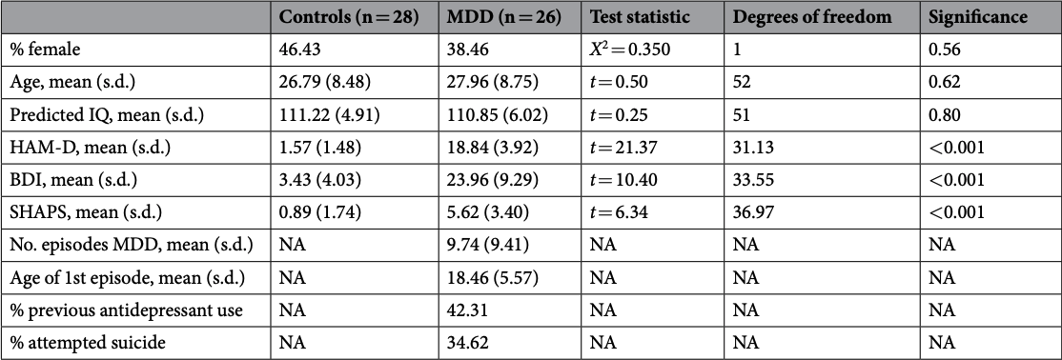
Participants
26 patients with MDD and 28 (super) healthy volunteers

Slide 15
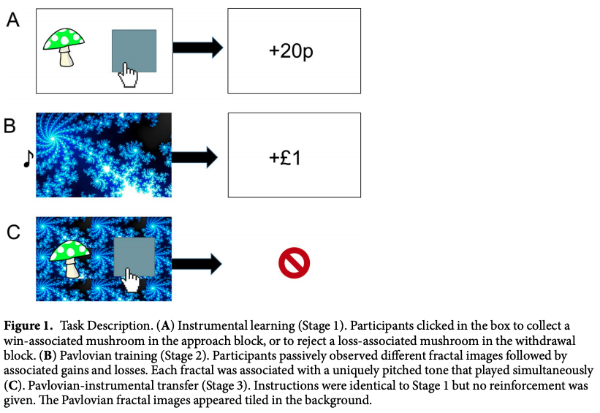
Pavlovian-Instrumental Transfer Task

Slide 16
Analyses
Repeated measures ANOVA to test effects of instrumental condition (approach/withdrawal) and action (go/no-go) on accuracy in Stage 1 instrumental learning, with group as a between-subjects factor.
Independent samples t-test to test group differences on Stage 2 Pavlovian choice accuracy.
Same repeated measures ANOVA as (1) to test if participants retained Pavlovian associations in Stage 3.
KEY HYPOTHESIS: Repeated measures ANOVA to test effects of instrumental condition (approach/withdrawal) and Pavlovian stimulus valence (large win/small win/neutral/small loss/large loss) on probability of making a ‘go’ response, with group as a between-subjects factor.

Slide 17
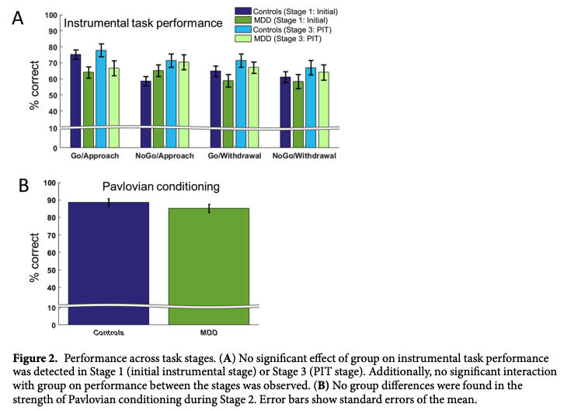
Results
Repeated measures ANOVA to test effects of instrumental condition (approach/withdrawal) and action (go/no-go) on accuracy in Stage 1 instrumental learning, with group as a between-subjects factor.
Results: Participants performed significantly better in approach than withdrawal blocks. There was no main effect of action (go vs. no-go) and no condition-by-action interaction. Groups did not differ in acquisition of contingencies.

Slide 18
Results
2. Independent samples t-test to test group differences on Stage 2 Pavlovian choice accuracy.
Results: No significant differences between groups.

Slide 19
Results
3. Same repeated measures ANOVA as (1) to test if participants retained Pavlovian associations in Stage 3.
Results: Unlike stage 1, there was no main effect of approach/withdrawal condition on accuracy. Again, there was no main effect of action, condition-by-action interaction, or main effect or interactions with group.

Slide 20
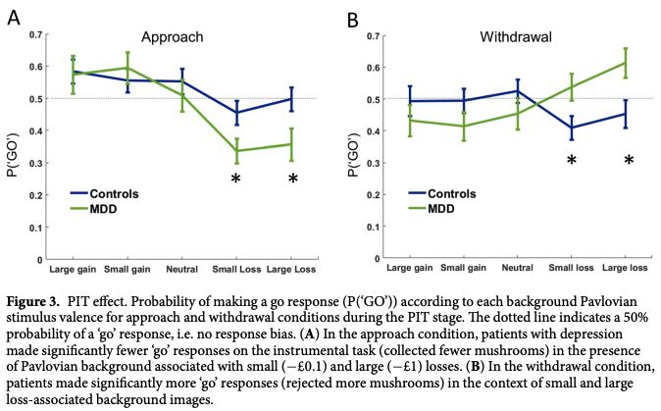
Results
4. Repeated measures ANOVA to test effects of instrumental condition and Pavlovian stimulus valence on probability of making a ‘go’ response, with group as a between-subjects factor.
Results: In approach, patients with depression made significantly fewer ‘go’ responses with small and large loss Pavlovian backgrounds. In withdrawal, patients made significantly more ‘go’ responses with small and large loss Pavlovian backgrounds.

Slide 21
Discussion

Slide 22
Some Thoughts
The authors argue that depression involves hyper-sensitive responses to negative stimuli, as well as hypo-sensitive responses to positive material.*
If behavior in depression is disproportionately guided by negative processing, we should see an enhancement of aversive PIT in people with depression compared to healthy controls.**
The rationale for the study was to investigate PIT in depression without the potentially confounding effects of current medication, which is known to alter serotonergic processing and could thus affect PIT.***
* this is likely the case for all of psychopathology, and not specific to depression

Slide 23
Some Thoughts
The authors argue that depression involves hyper-sensitive responses to negative stimuli, as well as hypo-sensitive responses to positive material.*
If behavior in depression is disproportionately guided by negative processing, we should see an enhancement of aversive PIT in people with depression compared to healthy controls.**
The rationale for the study was to investigate PIT in depression without the potentially confounding effects of current medication, which is known to alter serotonergic processing and could thus affect PIT.***
* this is likely the case for all of psychopathology, and not specific to depression
** this can’t tell us anything specific about depression (vs. general psychopathology or negative affectivity)

Slide 24
Some Thoughts
The authors argue that depression involves hyper-sensitive responses to negative stimuli, as well as hypo-sensitive responses to positive material.*
If behavior in depression is disproportionately guided by negative processing, we should see an enhancement of aversive PIT in people with depression compared to healthy controls.**
The rationale for the study was to investigate PIT in depression without the potentially confounding effects of current medication, which is known to alter serotonergic processing and could thus affect PIT.***
* this is likely the case for all of psychopathology, and not specific to depression
** this can’t tell us anything specific about depression (vs. general psychopathology or negative affectivity)
*** but they did not assess or exclude participants who were in therapy, which also alters serotonergic processing.

Slide 25
Group Discussion!

